Slide 1
The phrase “One hundred years of service to science” became the motto of our exposition.

Slide 2
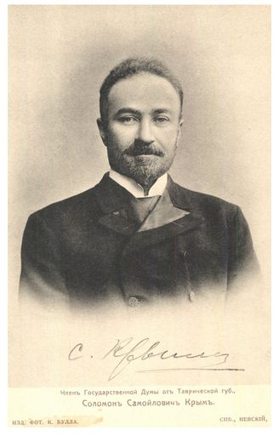
Solomon Samoilovich Krym was the first person who decided to create university in Crimea. Fourteenth of October 1918 the university was opened in the building of Russian Drama Theatre. Solomon Samoilovich Krym, the prime minister of Crimean government, facilitated to the opening of the university. Roman Ivanovich Helvig was the first rector. This was the first university in Crimea and twelfth in Russia. Helvig created a science library university, and the famous historian Nicola Lvovich Ernst became the head of the library.
Solomon Samoilovich Krym

Slide 3
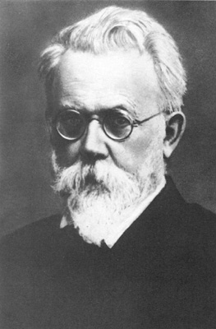
Initially Tavrida University consisted of five faculty: faculty of History and Philology, faculty of Physics and Mathematics, faculty of Law, faculty of Medicine and faculty of Agronomy. Thirteenth of October 1920 after the death of Helvig Vladimir Ivanovich Vernadsky became the second rector. The university was renamed in Michael Vasilievich Frunze Crimean University after Russian Civil War, because he captured the peninsula.
Vladimir Ivanovich Vernadsky

Slide 4
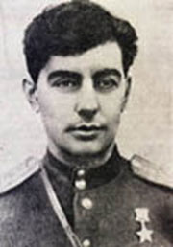
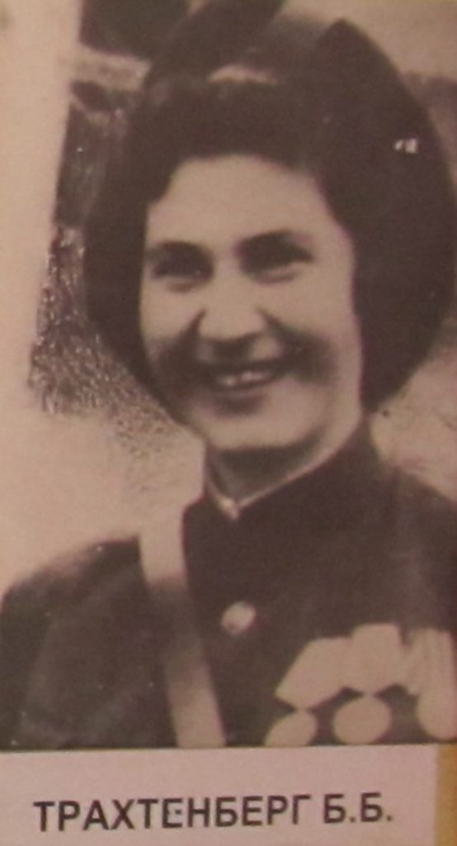
In this time the university established three separate educational institutions. There are a pedagogical, medical and agricultural institutions. In 1925 the university was named Crimean Pedagogical University. The Eastern Front of Second World War became a new test for the country. Professor of philology faculty Bella Borisovna Trahtenberg and graduate of the university Teyfuk Abdul became war heroes. Rector of the university Vasiliy Vasilievich Kulicovsky died in battle near Sevastopol.
Teyfuk Abdul

Slide 5
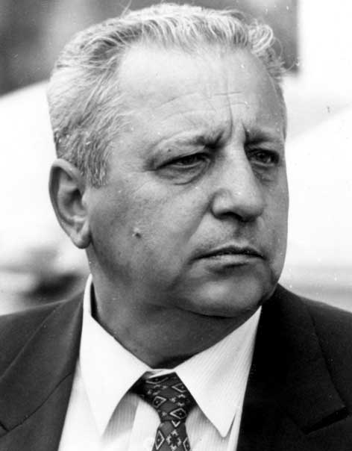
Studying process in Crimea after war restored on the first of October 1944. In 1965 the current main building of the university began to use, and soon dormitory buildings of the campus appeared nearby. In 1972 the university was renamed in M.V. Frunze Simferopol State University. University development is associated with the activities of the rector Perehoda A. F. Nicola Vasilievich Bagrov took the post of rector after the decay of the USSR. He was a rector fifteen years. The university tradition became a widespread work with international students when Bagrov was a rector. Today students from 53 countries study in our university.

Slide 6
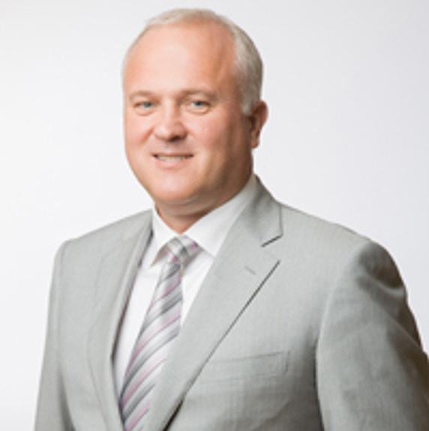
Spring 2014 Crimea became part of Russia and fourth of August was created V. I. Vernadsky Crimean Federal University. The university combined a number of higher institutions. The doctor of medicine Sergei Georgievich Donich became the head of the university. Today university wrote the new pages of his history.

